Slide 1
Canadian
evaluation group
IMT-2020 Evaluation Workshop
WP 5D Focus Meeting
Geneva, Switzerland
10th – 11th December 2019
www.IMT-CEG.ca

Slide 2
Overview Work accomplished, future work
Methodology
Work accomplished
Work to be done
www.IMT-CEG.ca

Slide 3
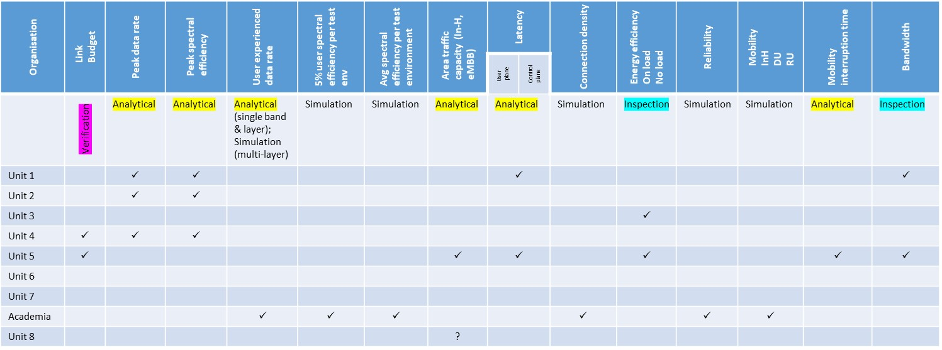
CEG – method of work
Work carried out in co-operative fashion
Technical co-ordinators (“Champions”) established for each of the 15 technical performance requirements, including link-budgets (private sector, government and academia)
Each of these co-ordinators worked with the others to perform the evaluation
Specifically, the academia
Implemented their own simulators (independent platforms)
Collaborated to ensure calibration
Produced results independently to evaluate the 5-6 parameters by simulation

Slide 4
CEG – work accomplished (as of December 2019)
Prepared and submitted the interim report to WP 5D
Contains results of evaluation via
Inspection
Analysis
Simulation
mainly of the submission in IMT-2020/3(Rev.4) (SRIT and RIT)
This evaluation applies to IMT-2020/4(Rev.4) and IMT-2020/5(Rev.4) in the CEG’s understanding (of the decision from WP 5D)
Thus no separate evaluation required

Slide 5
CEG – work accomplished #2 (as of December 2019)
Detailed link budget analyses carried out of the candidate submissions in IMT-2020/3(Rev.4) – for both SRIT and RIT
No significant differences perceived between CEG evaluation and proponent’s self-evaluation
Also of the link-budget of candidate submission in IMT-2020/7(Rev.3)
Clarification sought (and answer provided by proponent)
Discussion reflected in the ‘Evaluation Groups discussion area’

Slide 6
CEG – work accomplished #3 (parameters by simulation)
Test Environment | Evaluation Configuration |  |  | CEG
 | A | B | C
InH-eMBB 4 GHz – A 30 GHz – B 70 GHz – C | Avg spectral efficiency 5% spectral efficiency Mobility Area traffic capacity | Avg spectral efficiency 5% spectral efficiency Mobility Area traffic capacity | Avg spectral efficiency 5% spectral efficiency Mobility Area traffic capacity | Avg SE (A: TDD & FDD)  5% SE (A: TDD & FDD)  10, 20 & 120 km/h (A & B: TDD & FDD)  Only via analysis
DU-eMBB 4 GHz/1 layer – A 30 GHz/1 layer – B 4 & 30 GHz/(macro & micro) – C | Avg spectral efficiency 5% spectral efficiency Mobility | Avg spectral efficiency 5% spectral efficiency Mobility | User experienced data rate evaluation | Avg SE (A & B: TDD & FDD)  5% SE (A & B: TDD & FDD) 
RU-eMBB 700 MHz – A 4 GHz – B 700 MHz – C | Avg spectral efficiency 5% spectral efficiency Mobility | Avg spectral efficiency 5% spectral efficiency Mobility | Avg spectral efficiency for LMLC | Avg SE (A & B, TDD & FDD, C: FDD)  5% SE (A & B: TDD & FDD) 
UMa-mMTC 700 MHz – A 700 MHz – B | Connection density | Connection density |  | A: FDD 
UMa-URLLC 256 ant. elements per TRxP and 8 per UE – A 64 ant. elements per TRxP and 4 per UE – B | Reliability | Reliability

Slide 7
CEG work accomplished #4
Other results are being processed
Inspection (spectrum and services)
Analysis (User-experienced data-rate, latency, etc.)
Simulation (Reliability)
Proponents: 3GPP and DECT/ETSI-Forum, Nufront?
Relatively small thing – WRC-19 – got in the way!

Slide 8
CEG workplan (through the remainder of the evaluation period)
IMT-2020 SUBMISSION (document number in parentheses)
 | 3GPP |  | CHINA (#15) | KOREA (#16) | TSDSI (#19) | ETSI-DECT (#17) | Nufront (#18)
 | RIT (#14) | SRIT (#13)
Canadian Evaluation Group (CEG web site) | Will evaluate | Will evaluate | Not evaluate See Note 1 | Not evaluate See Note 1 | Partial evaluation See Note 2 | Partial evaluation (DECT component RIT) See Note 2 | Partial evaluation See Note 2
Parameters via Inspection
Bandwidth |  | 
Energy Efficiency |  | 
Spectrum
Services
Parameters via Analysis
Peak data rate |  | 
Peak spectral efficiency |  | 
User experienced data rate
Area traffic capacity |  | 
Latency (UP and CP)
Mobility interruption time |  | 
Parameters via Simulation
Average spectral efficiency | 
5% spectral efficiency | 
Mobility | 
Reliability
Connection density | 
Note 1 – The CEG will evaluate both
the SRIT and the RIT submitted by
3GPP. It is the CEG’s understanding
that such evaluation applies to the
candidates from China and Korea,
so no separate activity is foreseen
on those two submissions.
Note 2 – Further, the CEG intends
to evaluate the submissions from
TSDSI and ETSI (TC DECT)/DECT
FORUM (though in the case of the
latter, it will be only the DECT
component RIT, as the CEG’s
assumption is that the 3GPP
evaluation will apply to the 3GPP
component).
Finally, time permitting, the CEG
will also evaluate the candidate
submission from Nufront.

